Slide 1

URConnected
Group members: Allan Wambold, Carter Brezinski, Salim Bakri
Milestone 4, Dec 4th
https://github.com/ENSE-374/URConnected
Notes:
Carter
https://github.com/ENSE-374/URConnected

Slide 2
Project Vision
Why: We believe that students at the university are lacking communication with fellow students who have similar classes and interests
How: We aim to connect these students over a localized messaging platform
What: This web based forum known as ‘URConnected’ will allow for students to communicate in groups with students who share similar interests
Notes:
Salim

Slide 3
A Review of our “Deep Dive”
What exactly are we doing? Creating a functioning forum/messaging service for the UofR student body
What gap are you trying to fill? We’re trying to fill the lack of communication that the UofR students have
Project Vision: Students being able to navigate and communicate on this website
Stakeholders: The UofR students, possibly the UofR from a business standpoint
Assumptions: Students are lacking in communication and would use this website to fill that gap in communication
Constraints: Schedules, Scope, User Privacy
Notes:
Allan

Slide 4
Teamwork/responsibilities
Salim - Scrum Master, Lead Backend Developer
Backend & frontend skeleton, login & signup pages, communication between the backend and frontend
Allan - Lead Frontend Developer
Group page, Messaging system, communication between the backend and frontend, UML Diagram/Lo-fi prototype designer
Carter - Frontend Developer, Design Lead
Homepage, Navigation bar, styling, documentation & presentation
All of these tasks were done amongst the 4 milestones.
We chose these based on personal skill and overall experience in the field.
Notes:
Carter

Slide 5
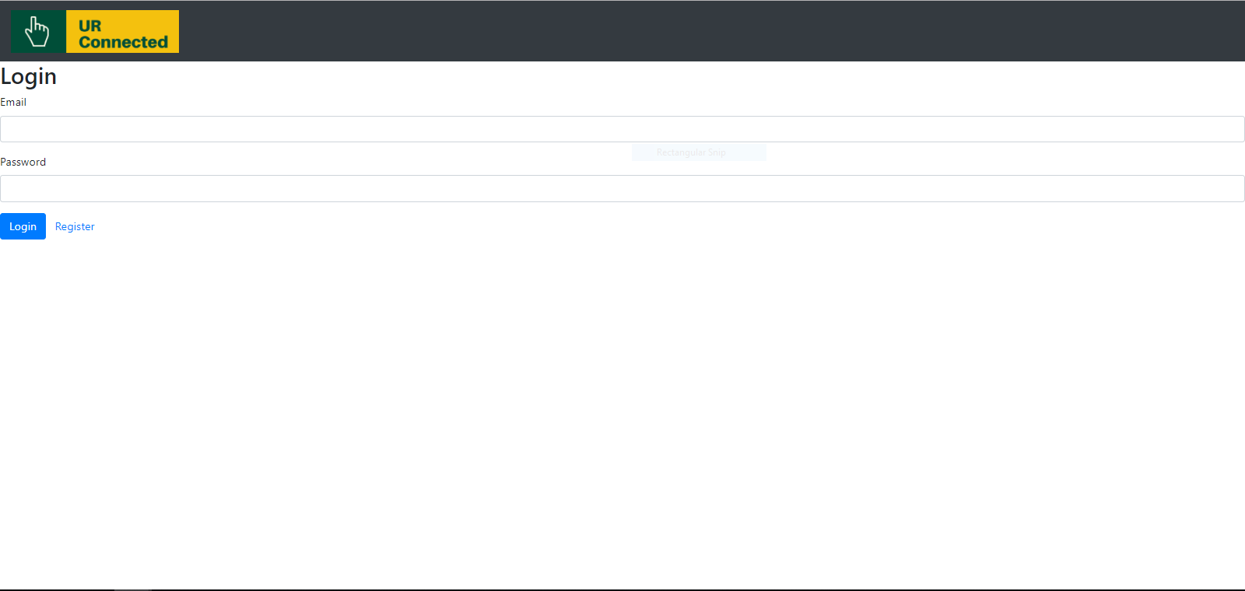
Screenshots - Login Page
Notes:
Carter

Slide 6
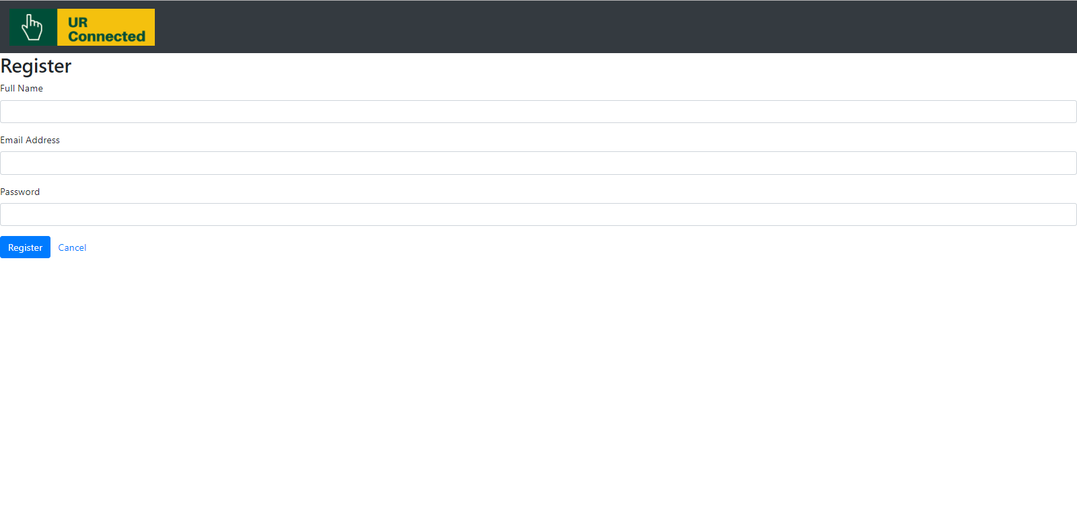
Screenshots - Signup Page
Notes:
Carter

Slide 7
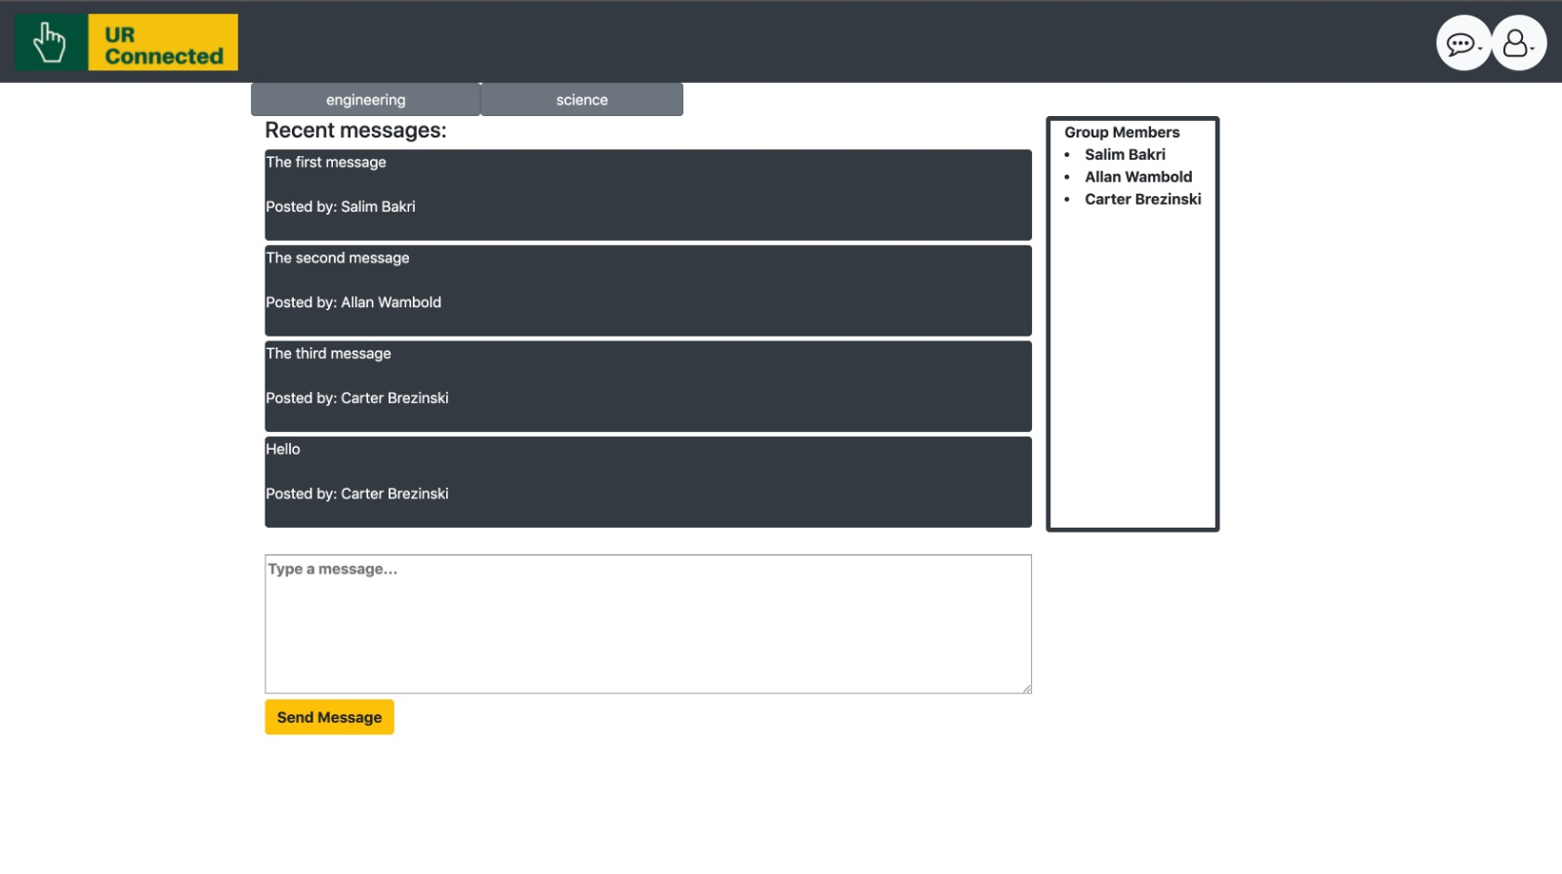
Screenshots - Group Page
Notes:
Carter

Slide 8
Demo
Notes:
We’ll each do our own part for the demo.

Slide 9
Our previously stated focus for the last MVP
Create an account with email verification
Successful login/logout.
Navigate through pages and groups
Being able to view the member’s details in a group.
When comparing to our previously stated goals, this milestone was a success.
Notes:
Allan

Slide 10
How does this MVP feel?
What are things you really like?
In comparison to last milestone, this feels a lot closer to a ‘finished product’
What are things you think might need some tinkering?
The front page isn’t fully fleshed out, we still consider it a work in progress, as there’s still plenty of features we initially thought of that could be implemented. A notification system.
Talk about this from the perspective of both MVPs (1 & 2)
From the perspective of MVP 1&2 we gave a good working product to people wishing to experiment and use the site. It still has issues and it isn’t perfect, but they’re able to see our work in progress.
Notes:
Carter

Slide 11
Feelings, future MVPs & GitHub
Do we consider this project a success? Short answer: Yes!
Our Highlights: We got the messaging page working, and the login/signup process is successful
Better-ifs: It would’ve been better if angular wasn’t so picky, it caused us a great deal of difficulty with its constant changes
How many changes/direction shifts did your team take? Little to no changes once we got our initial ideas down
Our future MVPs would have been structured similar to the following:
Add more groups
Add capability to add a group based on group tags
Customization of individual users
Have this operational on a live website
Notes:
Salim

Slide 12
Code Review
When making important commits for the project, we followed the guide on our github named ‘contributing.md’, this file basically contains recommended syntax for how you should word your commits and how to format your code.
Yesterday as a group we all sat down, merged our code, debugged, and ensured that the code was clean and that the code followed some of the formalities we went over in class. This includes proper naming conventions, meaningful variable names that avoid disinformation and give purpose.
Notes:
Carter
When making commits as a group, we chose to follow the guidelines of a file ‘contributing.md’ on our github; Yesterday as a group we all sat around, merged our code, and ensured that all of it was clean and followed some of the guidelines we went over in class. This included proper naming conventions in the right conditions,

Slide 13
https://github.com/orgs/ENSE-374/projects/1
Github Review
Notes:
Salim:
Speak about any updates to our Github page, the updated user stories and issues on our group Kanban Board, as well as the file structure and implementation of the FRD documentation as a markdown file.

Slide 14
Group reflection
How did you feel about this project? What did you like about it? What did you dislike?
This project went rather well, we’re all rather satisfied with the quality work that was produced in the time we spent working on this project.
What did you learn about yourself as you collaborated and worked through this project?
We learned we were all capable of working in a group and dividing up tasks to best achieve success within the initialized project scope
How will you use what you have learned going forward?
We’ll can use this group experience in our future classes, projects, and jobs
What “stuff & things” related to this project would you want help with? – Could have been better?
More time, we could have made a more fleshed out project if we were given an extra month or semester to work on it
Verification process could’ve been better/faster had we paid
Notes:
Carter

Slide 15

Questions?
Notes:
Carter
Questions?

